Slide 1
Location Based Garbage Management System with IOT for Smart City
Progress Presentation 2
Project ID : 17-100

Slide 2
G.S.B.Dabarera IT14005572
R.K.R.Ranaweera IT14005718
P.G.D.M Perera IT14008306
P.A.D.V.P Panangala IT14006326

Slide 3
Methodology

Slide 4
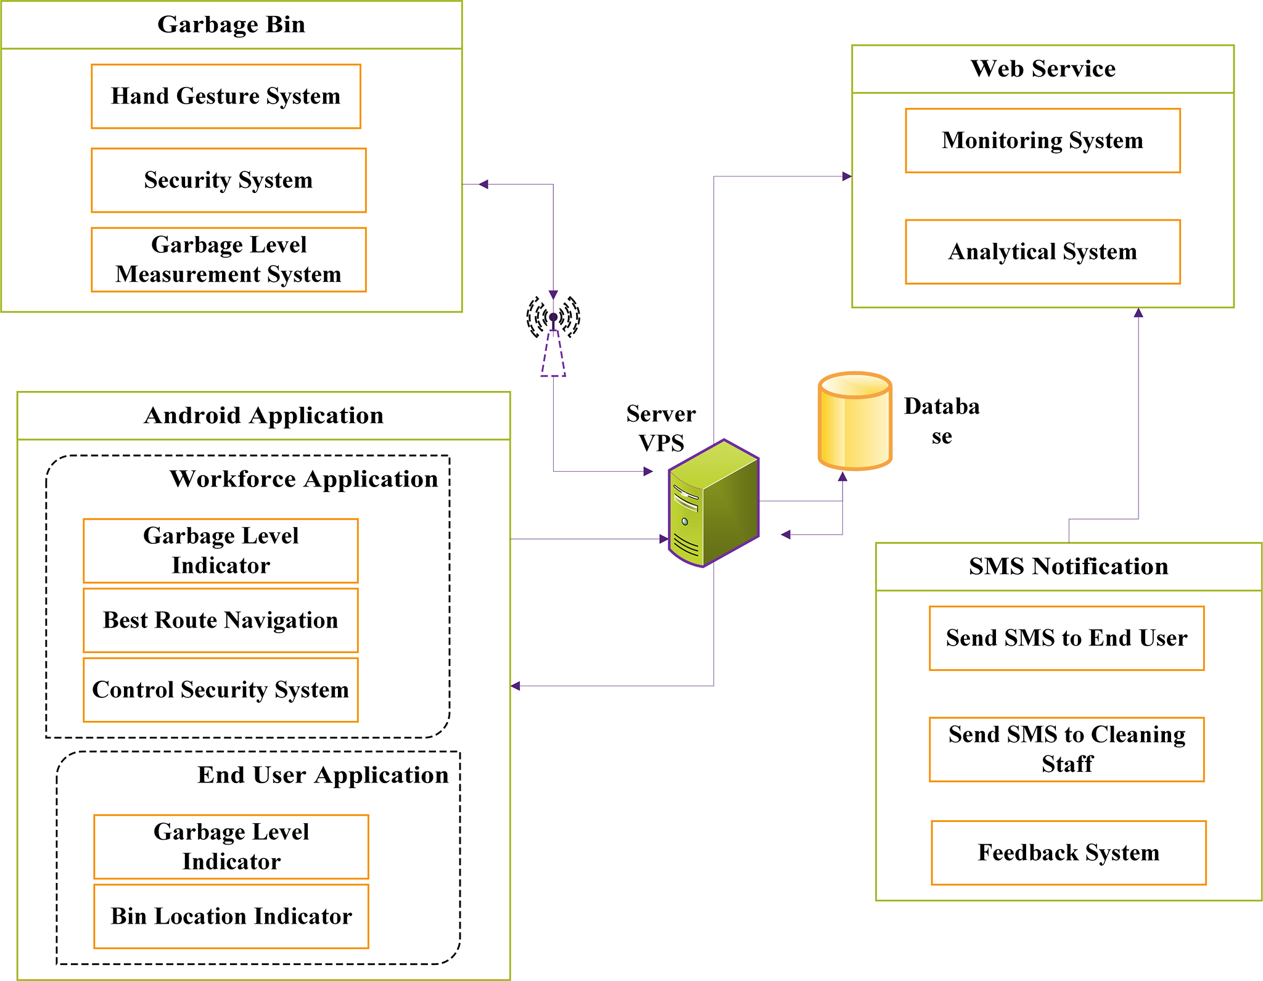
High-level Architecture

Slide 5
Setting up the Garbage Bin
All the Processes of the garbage bin are implementing on a Raspberry pi zero Development Board.
Setting the garbage bin will divide into three main sub-functions
Hand Gesture System
Measure the Real time Garbage level
Data Transfer
Bin lock mechanism
Security System

Slide 6

The Website
Client:
View real-time bin details
Request bins on specific locations
Receives system news and updates
Give Feedback
Admin:
View real-time bin details
Add, remove and update bin details.
Get monthly, annual reports.
Manage normal users

Slide 7

Android application development
While in the development stage two separate applications will be developed for the workforce and the user. After the two applications have been developed, the 2 apps will be merged together to form one final application
End user application Application
Real-time levels
Route calculation
Bin visualizer

Slide 8
End user application con….
In Bin location detail visualizer : This application also has the functionality to view all the bin locations and their fill levels through the given map.
In bin navigator : This provide a route to the nearest available bin. This route is calculated by considering the GPS location of the user. The best route from the current location to the nearest available bin is provided in the map provided in the application.

Slide 9

SMS Notification System
Develop web interface to get feedback from users.
Inform management
A system for users to request bins on specific locations or report malfunctions.
Ultimately provide better communication system

Slide 10
WorkForce application
This application also has the following functionality
Real-time levels
Route calculation
Bin Visualizer
disabling/re-enabling security system

Slide 11
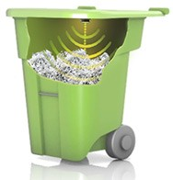
Real time levels
The map shows all the bins that are placed throughout the city. The cleaner can access each bin to get all the specific information about the bin like real time level, history of fill levels, etc.

Slide 12
Route calculation
When a certain bin reaches 80% fill level the cleaner receives the best route calculated to the 80% filled bin from the base station. This route is calculated taking into consideration some other bins that will be filled in a certain period of time in the future. These extra bins will be added as waypoints into the route.

Slide 13
How to build best route?
Use recent data that are exceed 80% filed level.
Use past data that are filed level each hours.
Develop an equation to each bins.
Develop best route based on identified waypoint.

Slide 14

Disabling and enabling security system
As mentioned earlier the bin has a security system that is enabled when its placed in the city. When a cleaner has to clean a bin, the security system has to be disabled in order to do so. This function enables the cleaner to disable the security system at the start and re- enable it when the cleaning is finished.

Slide 15
Testing and Evaluvation
Building
Implementing
Testing
The proposed system has to follow a set of testing phases to check the quality of the system.
This will help to evaluate the system of various aspects:
Accuracy
Efficiency
User friendliness
During the initial stages in the testing phase each and every group member carries out an individual testing on each single task completed.
After each successful completion on the unit testing on each task, each and every component is integrated.
Then an integration testing is performed, which will ultimately eliminate the integrated errors.

Slide 16

Testing and evaluvation con….
There is a testing phase when a system is initially setup in a city
In the 1st week
bins are placed on specific locations, data is collected and analyzed
the collected data is taken as past data to calculate routes
In the 2nd week
garbage are trucks implemented with routes
Feedback system for citizens is implemented
Then the system is evaluated by the managers for the implemented city.

Slide 17

Thanks!
Any questions?

